Slide 1
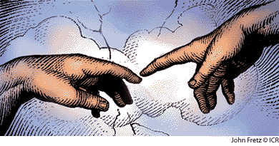
The Origin of Humans
Evolution or Made in God's Image?
Mike Riddle
m.riddle@verizon.net
www.train2equip.com
www.icr.org

Slide 2
Topics
A history of apemen – the track record
Two case studies
Neandertals
Australopithecines and Lucy
How evolution hinders critical thinking
Mechanism for change

Slide 3
Looking for Evidence
If the evolution of humans from an ape-like ancestor is true there should be two proof evidences:
The fossil record
A mechanism for change
If these evidences are absent, then the only alternative is special creation by God

Slide 4
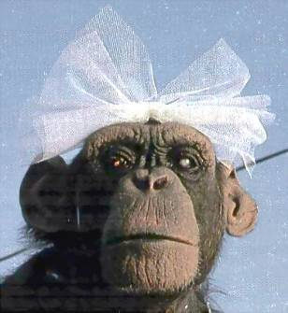
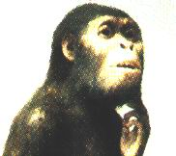
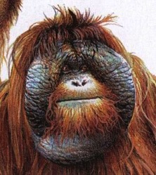
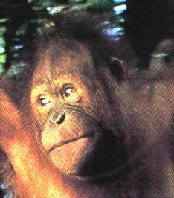
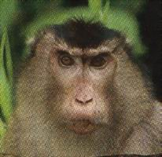
History of Man
The Bible teaches that God created man
Evolution begins with the assumption that man has evolved from ape-like creatures
So God created man in his own image, in the image of God he created him; male and female
Genesis 1:27
Pick your relative

Slide 5
School Textbooks
Holt, Rinehart, & Winston, Biology – Visualizing Life, 1998, p. 213.
“Look closely at your hand. You have five flexible fingers. Animals with five flexible fingers are called primates. Monkeys, apes, and humans are examples of primates….Primates most likely evolved from small, insect-eating rodentlike mammals that lived about 60 million years ago.”

Slide 6
School Textbooks
Miller and Levine, Biology, 2000, p. 757.
“But all researchers agree on certain basic facts. We know, for example, that humans evolved from ancestors we share with other living primates such as chimpanzees and apes.”

Slide 7
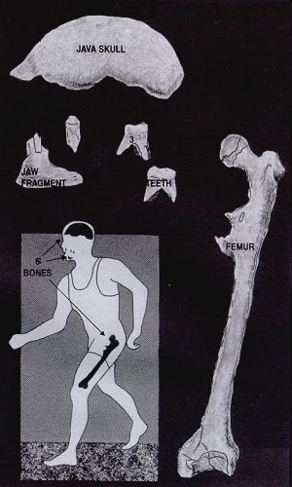
Java Man Pithecanthropus erectus
1891: An apelike skullcap and a humanlike thighbone were found 45 feet apart – claim: 500,000
Rudolph Virchow (regarded as the father of modern pathology) stated at the time of discovery:
“In my opinion this creature was an animal, a giant gibbon, in fact. The thigh bone has not the slightest connection with the skull.”

Slide 8
Java Man
Human fossils (Wadjak) were also found in Java dating about the same age as Java Man
Leading authorities of the time rejected Dubois's findings
Hackel, a prime promoter of evolution and Java Man, already had a reputation for fraud in promoting his views on evolution
Since 1950, anthropologists and textbooks have been calling Java man Homo erectus

Slide 9
Piltdown Man
Segment of lower ape-like jaw
Segment of human skull

Slide 10
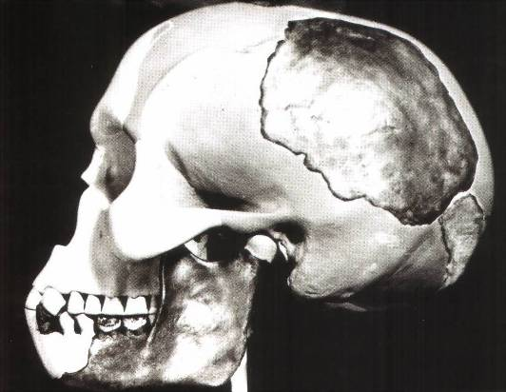
Piltdown Man
Parts found between 1908 and 1912 in Piltdown, England
Portion of human skull
Portion of lower ape-like jaw
The claim: 500,000 year old intermediate link

Slide 11
Piltdown Man
New York Times ran an article:
“Darwin Theory Proved True.”
Featured in textbooks and encyclopedias
In 1953 scientists studied the bones
The Truth
A fraud (600 year old bones)

Slide 12
Nebraska Man
1922 fossil evidence was discovered
Used to support evolution in the 1925 Scopes trial
The claim: 1 million year old intermediate link
The Truth
An extinct pig's tooth

Slide 13
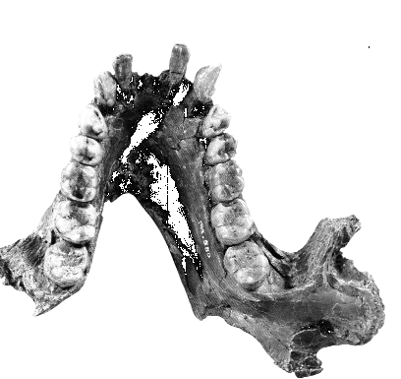
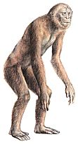
Ramapithecus
1930s
What they found
What they drew
Notes:
Pithecos = Greek for ape
Discovered in 1930s: jaw fragments and teeth

Slide 14
Ramapithecus
Time Magazine (Nov. 7, 1977)
“Ramapithicus is ideally structured to be an ancestor of hominids. If he isn't, we don't have anything else that is.”

Slide 15
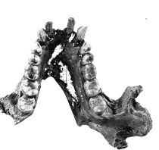
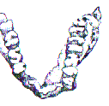
Ramapithecus
Pithecos = Greek for ape
Discovered in 1930s: jaw fragments and teeth
Time magazine (Nov. 7, 1977)
“Ramapithicus is ideally structured to be an ancestor of hominids. If he isn't, we don't have anything else that is.”

Slide 16
Ramapithecus
The claim: 14 million year old intermediate between ape-like creatures and humans
The truth
In 1970 a baboon living in Ethiopia was discovered.
Same dental structure
Similar morphological features found on Ramapithecus
Ramapithecus dropped from human line

Slide 17
Summary of “Facts”
Java Man ………… Two different creatures
Piltdown Man ……. Hoax
Nebraska Man ….. Pig
Ramapithecus ….. Ape
What about the dates?
In each case the date (age) was completely WRONG!

Slide 18
Ramapithecus
The Columbia Encyclopedia, Sixth Edition. 2001.
“An extinct group of primates that lived from about 12 to 14 million years ago, ….
Although it was generally an apelike creature, Ramapithecus was considered a possible human ancestor on the basis of the reconstructed jaw and dental characteristics of fragmentary fossils. A complete jaw discovered in 1976 was clearly nonhominid, however, and Ramapithecus is now regarded … to be an ancestor of the orangutan.”

Slide 19
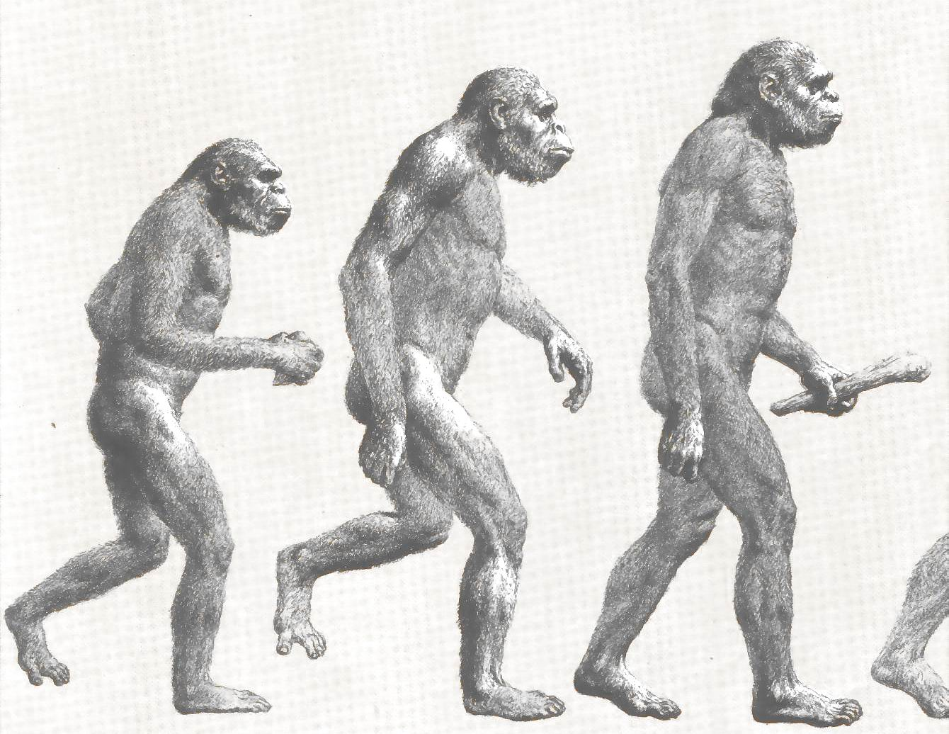
Two Case Studies
Neandertals
Lucy and the Australopithicines

Slide 20
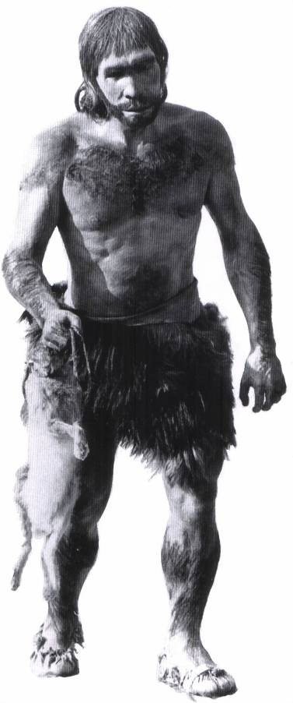
Case Study 1
Neandertals

Slide 21
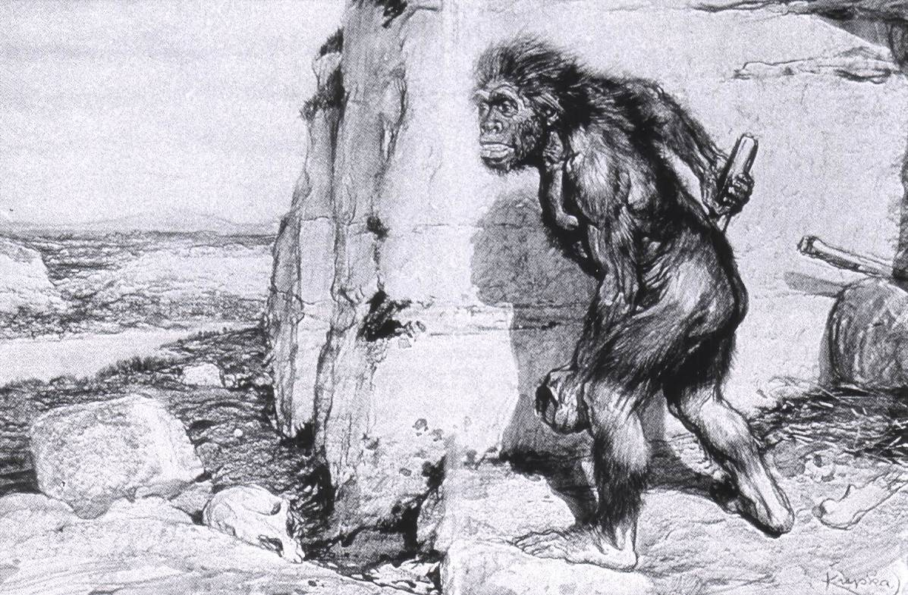
Neandertals
Original Drawing of Neandertal

Slide 22
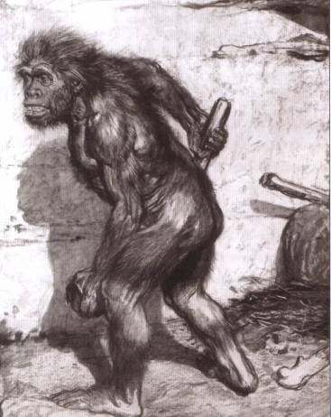
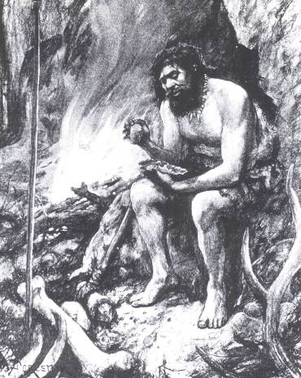
Neandertals
First found near Dusseldorf, Germany in 1856
Constructed to look ape-like
Brain capacity about 200 cc larger
Initial construction discovered to be wrong
Used jewelry
Used musical instruments
Did cave paintings
Capable of speech
Buried their dead

Slide 23
Neandertal Burial Cites
Marvin Lubenow, “Recovery of Neanderthal mtDNA: An Evaluation,” Creation Ex Nihilo Technical Journal, 1998 p.89.
“Most anthropologists recognize burial as a very human, and a very religious, act. But the strongest evidence that Neandertals were fully human and of our species is that at four sites Neandertals and modern humans were buried together.”

Slide 24
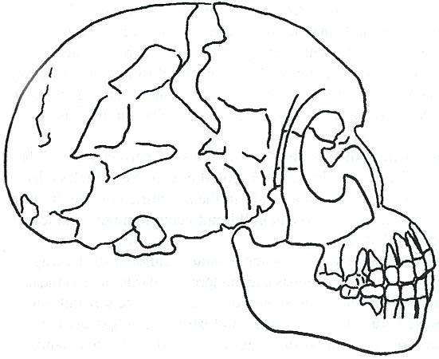
Rearranging the Data
From Buried Alive by Dr. Jack Cuozzo
Drawing of a Neandertal fossil purchased at the souvenir counter at the museum in Berlin giving an ape-like appearance
Lower jaw 30 mm (over an inch) out of the socket

Slide 25
Rearranging the Data
From Buried Alive by Dr. Jack Cuozzo
Flat, human appearance
Lower jaw 30 mm (over an inch) out of the socket

Slide 26
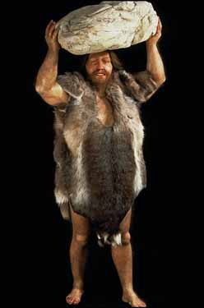
Neandertal Anatomy
Thick brow
Stocky body build
Short extremities

Slide 27
Neandertal Anatomy
B. Endo, “Experimental Studies on the Mechanical Significance of the Form of the Human Facial Skeleton,” J. Fac. Univ. Tokyo, 1966.
Biochemical models have demonstrated that chewing muscles working through the teeth generates intensive concentration of compression in the nasal and forehead region…i.e. a bigger brow ridge.

Slide 28
Neandertal DNA
Nicholas Comninellis, M.D., Creative Defense: Evidence Against Evolution, 2001, p. 195. (citing Marvin Lubenow, “Recovery of Neanderthal mtDNA: An Evaluation,” Creation Ex Nihilo Technical Journal, 1998.)
“Analysis of Neanderthal DNA failed to demonstrate any significance from DNA of modern humans.”

Slide 29
Neandertals Were Human
Dave Phillips (Physical Anthropologist), “Neanderthals Are Still Human,” Impact Article #223, May, 2000
“Neanderthals were human. They buried their dead, used tools, had a complex social structure, employed language, and played musical instruments.
Neanderthal anatomy differences are extremely minor and can be for the most part explained as a result of a genetically isolated people that lived a rigorous life in a harsh, cold climate.”

Slide 30
Neandertals Were Human
R. Ward and C. Stringer, “A molecular handle on the Neanderthals”, Nature, pp. 225–226.
“If early human populations were 'very small and isolated from one another', gradually each would accumulate 'different losses' [in mitochondrial DNA] until they all came to look really different from each other because of the drift. …
Nothing in the new data rules out the possibility that Neandertals interbred with ordinary Homo sapiens, which would make them part of the same species.”

Slide 31
Neandertal Population
Common dates for Neandertals are 130,000 to 30,000 years ago
Neandertals existed for about 100,000 years (2,500 generations: 40 years per generation)

Slide 32
Neandertal Population
From year 1 to 2,000 the population has grown from about 300 million to 6 billion (100 generations)
The Problem
There should have been over 50 billion Neandertals that lived during this time!
Where are the fossils?

Slide 33
Neanderthals
David Menton, (Ph.D. Cell Biology and 30 years Professor of Human Anatomy), “Making Monkeys Out of Man”, www.answersingenesis.org/docs2/4371gc8-28-2000.asp
“Despite the overwhelming evidence that Neanderthals were simply a race of stocky humans, imaginative artists (with the encouragement of some evolutionists) have consistently rendered them as stooped 'ape-men.'”

Slide 34
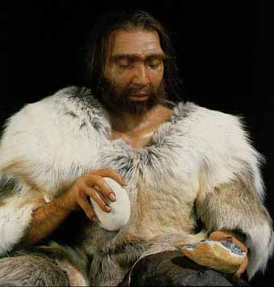
Conclusion About Neandertals
Protruding brow ridge
Stocky body build and short extremities
Isolated population of people
Lived in a cold, harsh climate
100% human
Neandertal man, reconstructed from a skull found in La Chapelle-aux-Saints, France

Slide 35
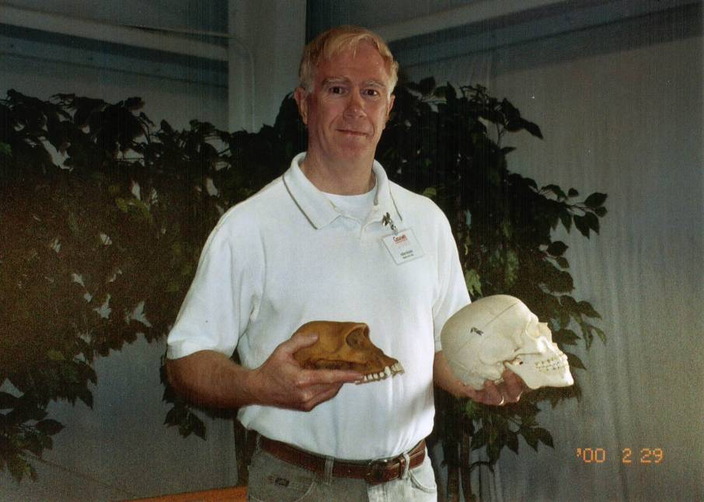
Case Study 2
Lucy and the
Australopithecines

Slide 36
Lucy
What was found?
How old is Lucy?
Did Lucy walk upright and how do we know?

Slide 37
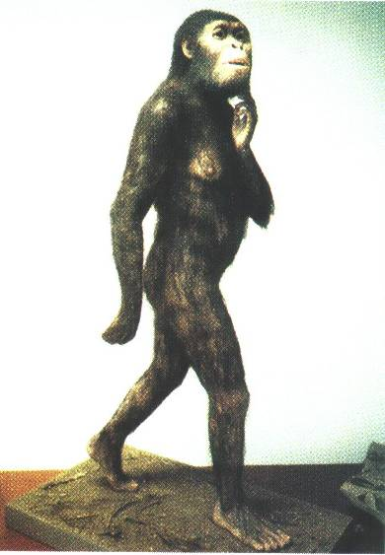
Lucy and the Australopithecines
Lucy discovered in 1974
About 40% of the fossil was found
Claimed to be 3.5 million years old
Claimed bipedal (walked upright)
Notes:
Picture of Lucy from: Biology: Understanding Life Third Edition, 2000

Slide 38
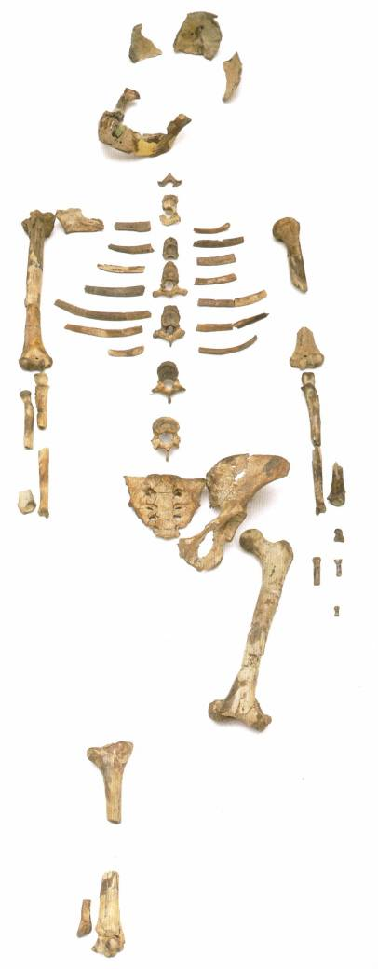
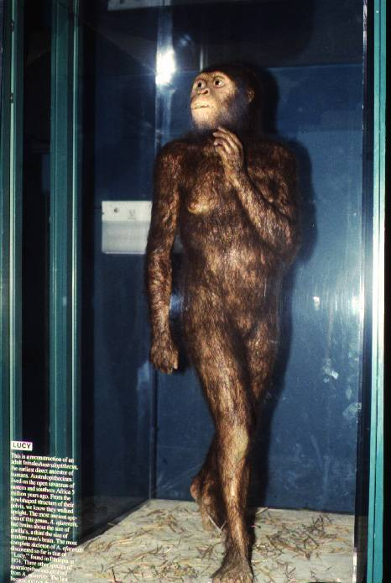
Lucy and the Australopithecines

Slide 39
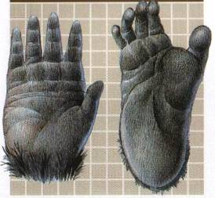
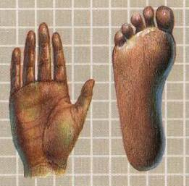
Lucy and the Australopithecines
No similarity in appearance to humans
Long arms are identical to chimpanzees
Jaws are similar to chimpanzees
Upper leg bone is similar to chimpanzees
Lucy's legs were very ape-like
Brain size (400-500 cc) overlaps chimpanzees
Large back muscles for tree dwelling
Hands similar to pygmy chimpanzee
Feet were long and curved

Slide 40
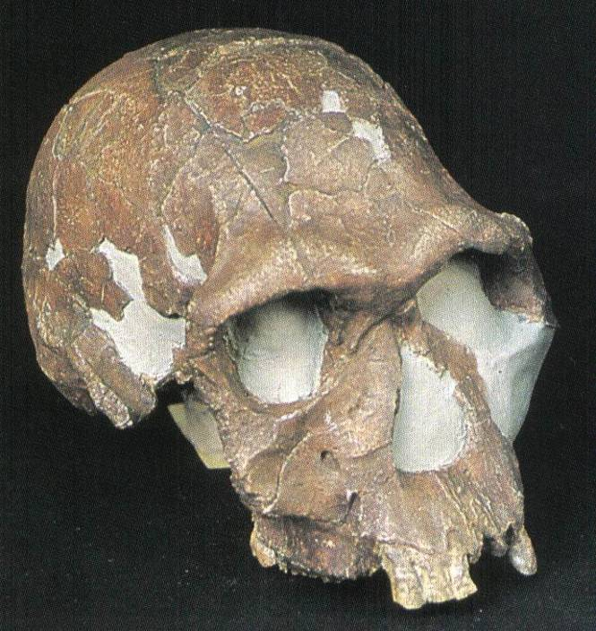
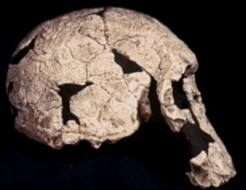
The Dating Game
In 1972 KNM-ER 1470 fossil found
Volcanic rock above 1470 dated at 2.6 myo
1470 claimed to be 2.9 myo
KBS Tuff
2.6 myo rock
1470 fossil
2.9 myo
Large brain capacity 800cc
Modern in appearance
Notes:
A problem: how can a fossil so modern looking be so old? Three options:
reassign the date for 1470
Make 1470 a distant primitive homo
1470 could be reevaluated to be an australopithecine
The first two occurred. 1470 was made a homo habilis and the new date was 1.8 myo
For years the KBS tuff (volcanic ash) was dated by potassium/argon dates to be 212 – 230 myo. (Nature Magazine) Then in 1972, KNM-ER 1470 was found (KNM-ER a museum id code: Kenya National Museum, East Rudolf). It was found under the tuff by Richard Leakey. It looked like modern humans but dated at 2.9 myo.
Later 10 different dates of the tuff were taken to be .52 – 2.64 myo. This is quite a difference from 212 myo!
The KBS tuff is about 3 feet thick and covers an area of about 50 miles

Slide 41
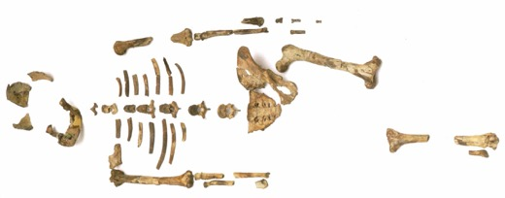
Lucy and the Dating Game
2.6 myo rock
Lucy
3.0 myo rock
A BIG Problem
Notes:
Confirmed by many potassium dates. Lucy is now dated at 2.9 myo

Slide 42
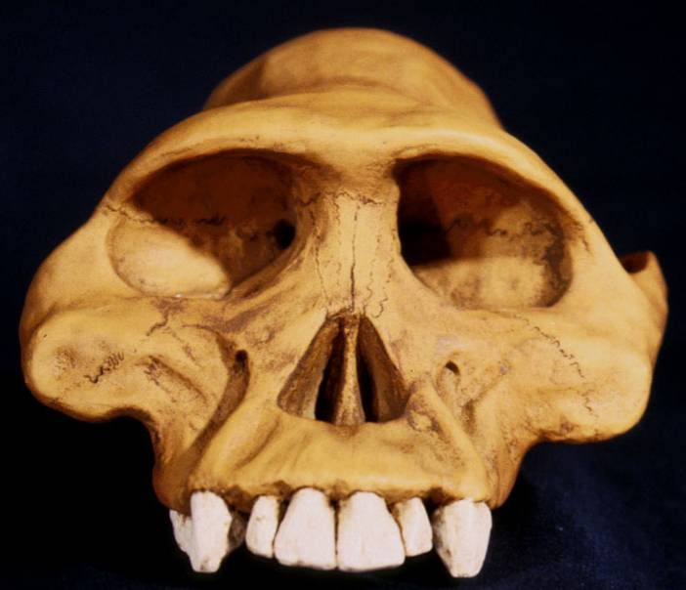
The Problem and the Solution
Lucy: ape-like 2.9 myo
1470 skull: modern appearance 2.9 myo
Ape-like appearance
Modern looking
How Do Evolutionists Solve This?
Notes:
Basil Cooke, a pig expert, had assembled a detailed sequence of several separate pig lineages over a period of a couple of million years. The claim: the evolution of pigs is consistent worldwide and therefore the pig sequences found at Hadar could determine the age of Lucy.
Fossil elephants gave a date of 2.5 myo but fossil pigs 2.0 myo. Why did they go with the pigs? It better fit the evolution model.
Early attempts to date the KBS tuff (1969) gave an age of 212-230 million years which was immediately rejected as an extraneous argon age discrepancy, because of the presence of Australopithicine and other mammalian fossils beneath the tuff (Fitch & Miller 1970, Nature 226:226-8).
In the early 1970's the KBS tuff was "securely dated" at 2.6 million years based on: Vertebrate faunas -- Elephant, Suid (pig), Australopithicus, and tools

Slide 43
Solution
Throw out the potassium/argon dates and use fossil pig sequences to re-date Lucy (3.5 myo)

Slide 44
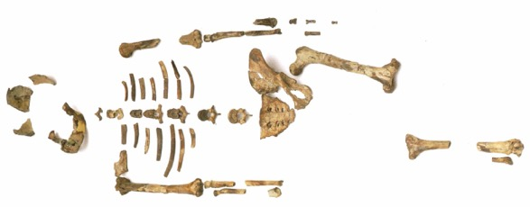
Dating Method Accuracy
If the evolutionists do not trust potassium argon dates, then why should the public be led to trust them?
Potassium/argon dates
Fossil pig sequences
Notes:
If the evolutionists do not trust potassium argon dates then why should the public be led to trust them?
Early attempts to date the KBS tuff (1969) gave an age of 212-230 million years which was immediately rejected as an extraneous argon age discrepancy, because of the presence of Australopithicine and other mammalian fossils beneath the tuff (Fitch & Miller 1970, Nature 226:226-8).
In the early 1970's the KBS tuff was "securely dated" at 2.6 million years based on: Vertebrate faunas -- Elephant, Suid (pig), Australopithicus, and tools

Slide 45
Did Lucy Walk Upright?
1987 Charles Oxnard (Professor of Anatomy and Human Biology) Computer analysis
1992 American Journal of Physical Anthropology, Walked like chimpanzees
1993 Christine Tardieu, (Anthropologist) reported, “Its locking mechanism was not developed.”
1994 Journal of Human Evolution, A Biochemical Study of the Hip and Thigh

Slide 46
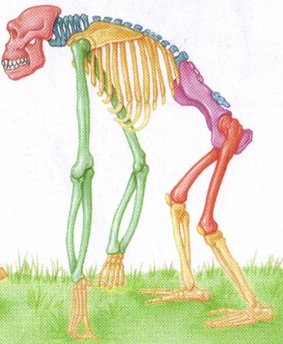
Did Lucy Walk Upright?
Richmand and Strait, “Evidence that Humans Evolved from Knuckle-Walking Ancestor,” Nature, 2000.
“Regardless of the status of Lucy's knee joint, new evidence has come forth that Lucy has the morphology of a knuckle-walker.”
E. Stokstad, “Hominid Ancestors May Have Knuckle Walked,” Science, 2000.
“I walked over to the cabinet, pulled out Lucy, and shazam! – she had the morphology that was classic for knuckle walkers.”

Slide 47
Confusion about Lucy
Robert Boyd and Joan Silk, (both professors of anthropology), How Humans Evolved, 2000, pp. 331-334.
“Anatomical evidence indicates that A. afarensis was bipedal…”
…some anthropologists are convinced by the anatomical evidence that A. afarensis was not a modern biped.”
Why the confusion?
Why aren't students told about this?

Slide 48
Did Lucy Walk Upright?
Stuart Burgess (Ph.D. CEng), Hallmarks of Design, 2002, p. 166.
“There are so many unique features required for bipedal motion that it is impossible for a quadruped to gradually evolve into a biped.”

Slide 49
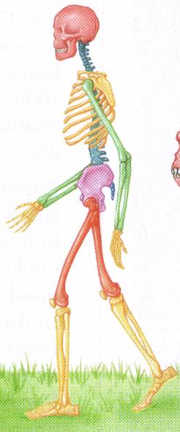
10 Unique Characteristics
Fine balance
Flat face
Upright skull
Straight back
Fully extendable hip joints
Angled femur bones
Fully extendable knee joints
Long legs
Arched feet
Strong big toes
Notes:
All these deal with being bipedal
FINE BALANCE: Requires a fine sense of balance. The inner ear has a network of fluid-filled canals which contain sensors which are sensitive to movement and gravity. The sensors consist of fine hairs which send out signals to indicate direction and speed. Humans have a more complex inner ear design than apes
FLAT FACE: So their eyes have a field of view which extends down to the ground in front of the feet.
UPRIGHT SKULL: the position at which the spinal cord enters the skull. In humans it is located at the bottom of the skull. This means the most natural position for the head is looking forward in the upright position.
STRAIGHT BACK: This is ideal for upright posture because the torso and head are directly above the hips in the standing position. Apes have a curved back.
FULLY EXTENDABLE FEMUR BONES: When looking from the front humans have femur bones which are angled inwards as they come down from the hip. This has the effect of making the knees and feet closer together. Having feet closer together keeps the feet nearly under the center of the body and gives stability during walking and running. During walking and running the body is supported by one leg at any instant and so the body can topple over if the legs are not right under the body. If the feet were not close together then the body would be thrown from side to side
FULLY EXTENDABLE KNEE JOINTS:
VERY LONG LEGS: The length of human legs is about half the total body. This makes it possible to walk and run for long distances with relative ease. In contrast, apes are only about a third.
ARCHED FEET: The human foot is arched between the ball of the foot and the toes. The foot has around 26 bones and many muscles and ligaments, tendons and nerves so the foot can flex between the heel and the ball. The arched structure of the foot makes it easy for a person to press down on the ball for the foot which is important for balance and control. This ability is also important for movements such as standing on tiptoe, running and turning. It also helps absorb shocks during walking and running. In contrast the feet and hands of apes are like hands suited for grasping.
STRONG BIG TOES: This feature is important for walking and running. For each step, the final push from the ground comes from the big toe. In order to propel the body forwards in a controlled manner, the big toe must be very strong. Apes have a toe designed for grasping. They cannot make a firm push from their big toe.

Slide 50
Did Lucy Walk Upright?
Dr Spoor, Anatomist and editor of the Journal of Human Evolution
“Dr Fred Spoor has done CAT scans of the inner ear region of some of these skulls. These show that the semi-circular canals, which determine balance and ability to walk upright, resemble those of the extant great apes.”
F. Spoor, “Implications of early hominid labyrinthine morphology for evolution of human bipedal locomotion,” Nature, June 1994 (reported in Creation, 2003, p. 17.)
Notes:
FRED SPOOR -- (Ph.D Utrecht University, 1993) Professor of Evolutionary Anatomy, Dept. of Anatomy & Developmental Biolology, UCL Joint editor of Journal of Human Evolution.

Slide 51
Did Lucy Walk Upright?
Charles Oxnard (professor of anatomy and leading expert on australopithecine fossils), The Order of Man: A Biomathematical Anatomy of the Primates, 1984, p. 332.
“The australopithecines known over the last several decades … are now irrevocably removed from a place in the evolution of human bipedalism,…
All this should make us wonder about the usual presentation of human evolution in introductory textbooks…”

Slide 52
Lucy and Chimpanzees
Joseph Weiner, The Natural History of Man, 1971, pp. 45-46.
“The first impression given by all the skulls for the different populations of Australopithecines is of a distinctly ape-like creature…
The ape-like profile of Australopithecus is so pronounced that its outline can be superimposed on that of a female chimpanzee with a remarkable closeness of fit.”

Slide 53
Conclusion on Lucy
William Fix, The Bone Peddlers, 1984, p. xxii.
“Lucy seemed to be more of a promotion to convince the public that Johanson's fossils were more important than Richard Leakey's rather than an attempt to present an evenhanded assessment of current paleoanthropology.”

Slide 54
How Evolution Hinders Critical Thinking

Slide 55
Australopithecine Anatomy
Richard Milton, Shattering the Myths of Darwinism, 1997, p. 207.
“… anatomists Jack Stern and Randall Susman,… described Lucy's hands and feet as being long and curved, typical of a tree-dwelling ape.”

Slide 56
Australopithecine Anatomy
David Menton, Ph.D. Cell Biology, Biomedical research technician at Mayo, and 34 years Professor of Human Anatomy
“Menton cites evolutionary sources which show that creatures in this species had hands and feet which were 'not at all like human hands and feet; rather, they have long curved fingers and toes'—even more so than apes today that live mostly in the trees.”
Creation ex nihilo, Dec 1996, p. 52.

Slide 57
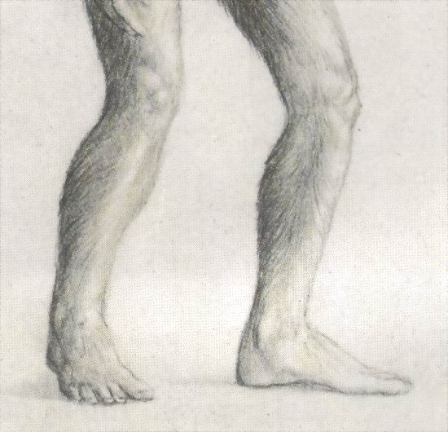
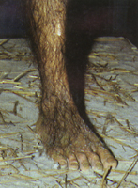
Lucy: What Nice Feet You Have
Drawing from Life: The Science of Biology, Purves, Orians, and Heller, 1992, p. 604.
St Louis zoo replica of Lucy

Slide 58
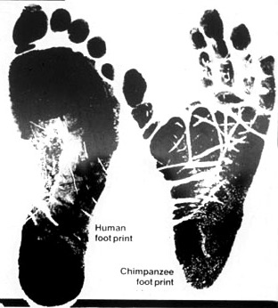
Apes and Humans – a Test
Human
Which footprint is human?
Notes:
This is not hard to distinguish

Slide 59
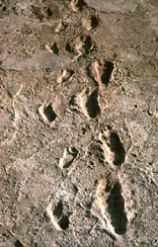
Laetoli Footprints
Footprints discovered in 1978 in Laetoli, Tanzania. The footprints were dated at 3.5 million years old.
Who made these footprints?

Slide 60
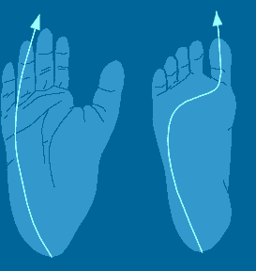
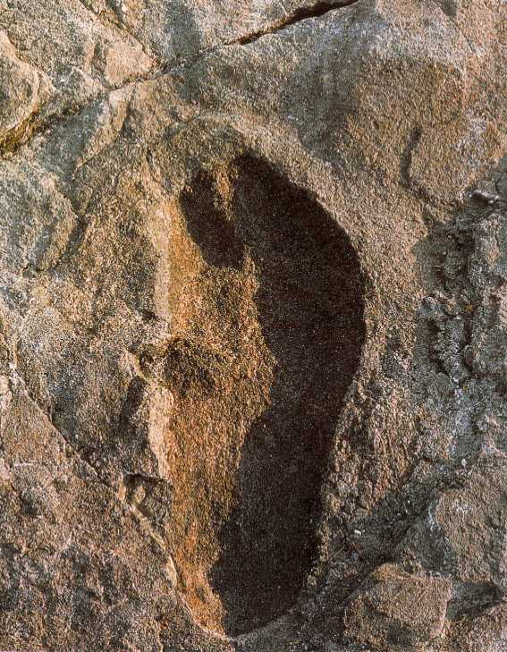
Ape and Human Footprints
Human
Ape
(Lucy)
Laetoli footprint

Slide 61
Footprints and Real Evidence
Tim White, “Evolutionary Implications of Pliocene Hominid Footprints,” Science, April 1989, p. 175.
“The uneroded footprints show a total morphological pattern like seen in modern humans.”

Slide 62
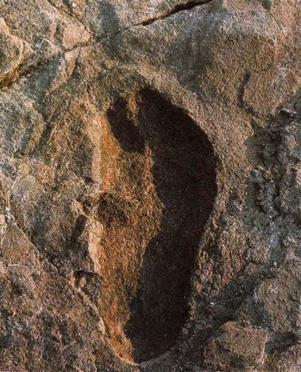
Footprints and Real Evidence
Russell Tuttle, “The Pattern of Little Feet,” American Journal of Physical Anthropology, Feb 1989, p. 316.
“Indistinguishable from those of habitually barefoot Homo sapiens.”

Slide 63
Laetoli Footprints
Donald Johanson and Maitland Edey, Lucy: The Beginnings of Humankind, 1981, p. 250.
“There is a well-shaped modern heel with a strong arch and a good ball of the foot in front of it. The big toe is straight in line. It doesn't stick out to the side like an ape toe,…”
Straight big toe
Strong arch
Heel – toe movement
Notes:
All these are characteristic of humans not apes or Lucy

Slide 64
Time: The Holy Grail
Ignoring the Evidence
Robert Boyd (professor of anthropology) and Joan Silk (professor of anthropology), How Humans Evolved, 2000, p. 334.
“Who made these footprints? A. afarensis is the likely suspect because this is the only hominid whose remains have been found at Laetoli, and A. afarensis is the only known hominid to have lived in East Africa at the time the tracks were made.”

Slide 65
The Evolution Solution
Russell Tuttle, “The Pitted Pattern of Laetoli Feet,” Natural History, Mar 1990, p. 64.
“In sum, the 3.5-million-year-old footprint trails at Laetoli site G resemble those of habitually unshod modern humans.
None of their features suggest that the Laetoli hominids were less capable bipeds than we are.”
What about the education system?

Slide 66
Textbooks Promoting Bad Science
Biology: Visualizing Life, Holt, Rinehart, and Winston, 1998, p. 221.
“Another important find was the footprints of a group of bipedal animals…
They reveal small but very humanlike feet, lacking the ape's opposable toe. Our ancestors or very close relatives were walking upright only 1.5 million years after diverging from the chimpanzee line.”

Slide 67
Textbooks Promoting Bad Science
Biology: Principles and Explorations, Holt, Rinehart, and Winston, 2001, p. 307.
“Lucy's leg bones indicate that she must have walked upright. She stood about 1 m (3 ft) tall.”

Slide 68
Textbooks Promoting Bad Science
Biology: Concepts and Connections, 2000, p. 404.
“Some 3.7 million years ago, several bipedal (upright-walking) human animals of the species Australopithecus afarensis left footprints in damp volcanic ash in what is now Tanzania in East Africa.”

Slide 69
Anatomy of Australopithecines
David Catchpoole, Ph.D., “New evidence: Lucy was a knuckle-walker”, www.answersingenesis.org/docs2/4256news5-5-2000.asp
“A serious reconstruction error is to wrongly align Lucy's big toe alongside the smaller toes, like a human foot. …
anatomist Dr Charles Oxnard has shown that the big toe actually sticks out as in chimpanzees.”

Slide 70
Evolution Rejects the Evidence
“Professor Betsy Schumann, evolutionist expert, admits that the statue's feet 'probably are not accurate', but when asked whether the statue should be changed, she says,
'Absolutely not'.”
Creation ex nihilo, Dec 1996, p.52.
In other words, it doesn't matter if people get indoctrinated into evolution by wrong evidence

Slide 71
Conclusion on Bipedalism
F. Spoor, B. Wood and F. Zonneveld, Implications of early hominid morphology for evolution of human bipedal locomotion, Nature 369(6482):645–648, 1994.
Cat Scans of the inner ear canals (reflecting posture and balance) of 53 humans, over 20 apes, fossil humans (early Homo), and Australopithecines by anatomist Dr Fred Spoor and his colleagues at University College, London, showed they did not walk habitually upright.
Why is this information not in textbooks?
Notes:
This is not a quote, but summary of the information
The anatomy of the semicircular canals of australopithecines is also interesting. The semicircular canals are three small, loop-shaped structures in the inner ear, arranged roughly at right angles to each other. These structures are responsible for giving us our sense of balance by allowing us to orient ourselves with respect to a gravitational field. In the early 1990s, a scientist by the name of Spoor decided to study these canals. He compared the canals of many living primates, to include humans, with some "hominid" fossils. He used a computerized tomography scanner (CT-scanner) to do this. His results were very interesting. The canals of Australopithecus africanus and robustus were most similar to the great apes. Spoor and his associates concluded that this finding was consistent with the idea that these creatures were at least partly arboreal and that they "did not walk habitually upright," but Spoor still believed them to be partly bipedal as well.

Slide 72
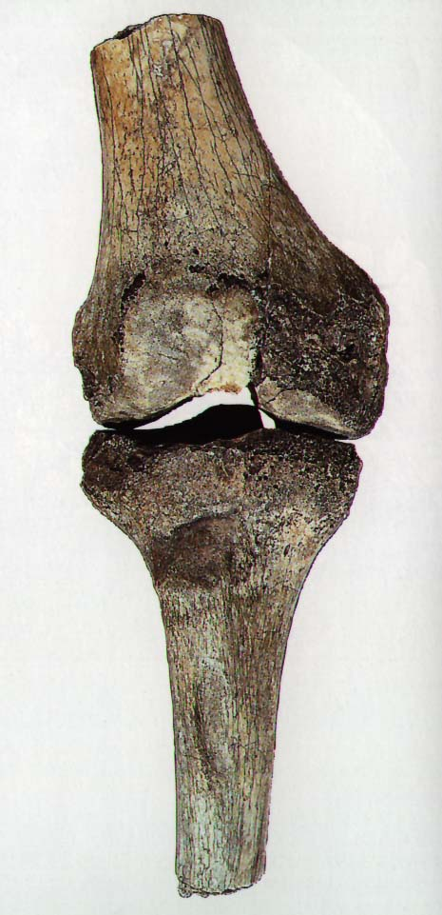
Knee Joint of A. afarensis
15° carrying angle (valgus)
Human = 9°
Gorilla = 0°
Chimp = 0°
Orangutan = 9°
Spider monkey = 9°

Slide 73
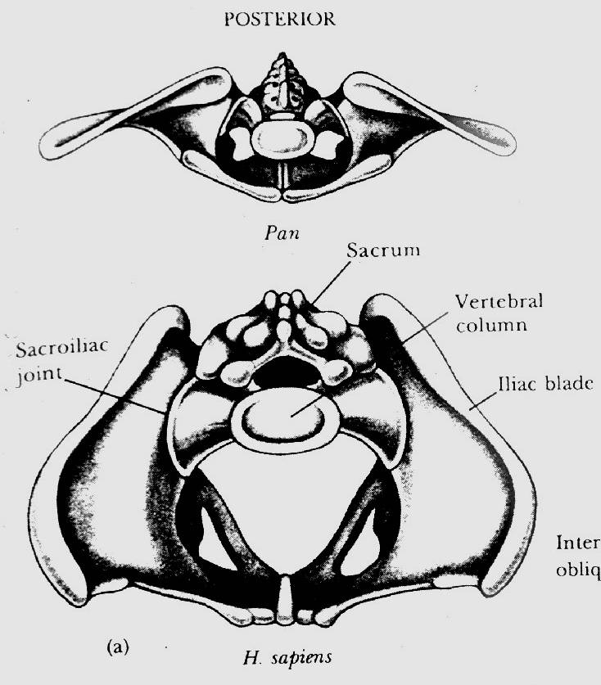
Chimp vs. Human Pelvis
Chimp
Human

Slide 74
Lucy's Pelvis
J. Stern & R. Sussman, American Journal of
Physical Anthropology, 1983, pp. 291 & 292.
“The fact that the anterior portion of the iliac blade faces laterally in humans but not in chimpanzees is obvious. The marked resemblance of AL 288-1 (Lucy) to the chimpanzee is equally obvious…
It suggests to us that the mechanism of lateral pelvic balance during bipedalism was closer to that in apes than in humans.”

Slide 75
Lucy's pelvis is “wrong” because it is very ape-like
PBS Nova Series; In Search of Human Origins
episode one 1994 (Dr. Owen Lovejoy)

Slide 76
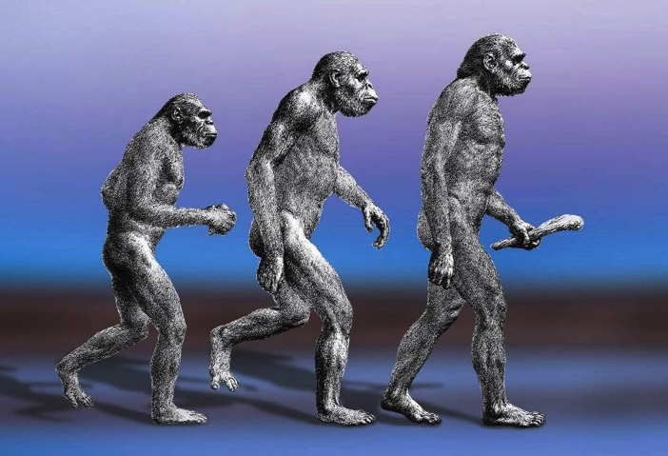
A Question
How accurate are the casts and pictures in the textbooks and museums?
Notes:
We see pictures of fossils and creatures in textbooks

Slide 77
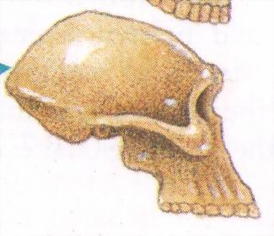
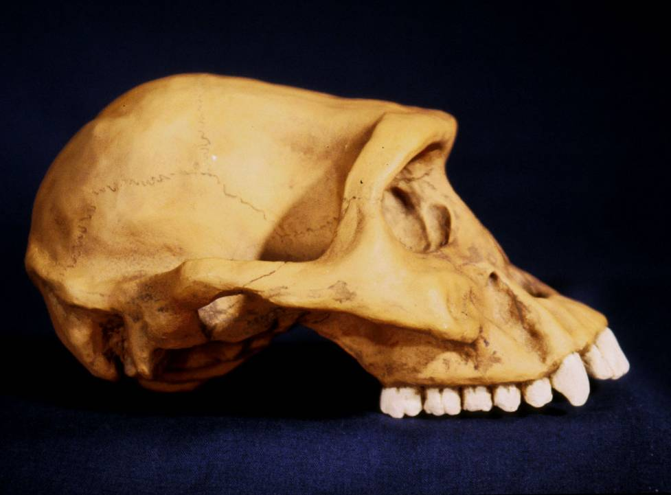
Textbooks and Accuracy
Eye socket
2
3
Flatter face
Teeth
1
Biology: The Web of Life, 1993

Slide 78
Evolution and Objectivity
Philip Johnson, Darwinism on Trial, 1991, p. 84. (Graduate of Harvard U., Law Professor at U. of Berkeley)
“The Darwinist approach has consistently been to find some supporting fossil evidence, claim it as proof for 'evolution,' and then ignore all the difficulties.”

Slide 79
Evolution and Censorship
Jonathan Sarfati (Ph.D. Physical Chemistry), Refuting Evolution, 2002, p. 198.
“…It is evident that the evolutionists fear the increasing spread of creationist information, despite their best efforts at censorship.
So they are desperate to counteract this information. But their efforts don't withstand scientific scrutiny,…”

Slide 80
Science and Evolution
In order to be a credible model all the evidence must be examined. This has not be done. Why?
Perhaps to promote evolution rather than real science

Slide 81
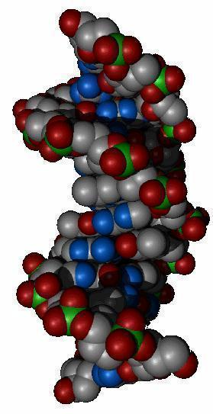
Mechanism for Change
Natural Selection
Mutations

Slide 82
Evolution and Change
A beneficial mutation occurs
Natural selection selects this mutation over any existing genes or other detrimental mutations that code for this function
The mutation is inherited by offspring
KEY: This process must add
New Information

Slide 83
Natural Selection
Genetic Variation
Ability to adapt to the environment
Survival of the fittest
Can natural selection cause one kind (species) to become a new kind?
No!
Natural selection ONLY works with existing information

Slide 84
Natural Selection
Elmer Noble, Ph.D. Zoology,
Glenn Nobel, Ph.D. Biology,
Gerhard Schad, Ph.D. Biology,
Austin MacInnes, Ph.D. Biology,
Parasitology: The Biology of Animal Parasites, 1989, p. 516.
“Natural selection can act only on those biological properties that already exist; it cannot create properties in order to meet adaptational needs.”

Slide 85
Natural Selection
Franklin M. Harold (Professor of Biochemistry and Molecular Biology, Colorado State University), The Way of the Cell, 2001, p. 204.
“Selection is for the here and now; it has no foresight, and cannot anticipate what functions may be useful in the future.”

Slide 86
Natural Selection
Robert Boyd (professor of anthropology) and Joan Silk (professor of anthropology), How Humans Evolved, 2000, p. 334.
“Mutation introduces new, usually deleterious, variants, and natural selection removes these variants.”

Slide 87
Natural Selection and Mutations
If evolution is true
Mutations and disorders
Natural selection should eliminate harmful disorders
Time

Slide 88
Natural Selection and Mutations
12000
10000
8000
6000
4000
2000
0
Mendelian Inheritance in Man
encyclopedia of human genes and disorders
MIM Entries
Observed data
1965 1970 1975 1980 1985 1990 1995 1999

Slide 89
Natural Selection
Neil Broom, How Blind Is the Watchmaker, 2001, p. 165. (Ph.D. Chemical and Materials Engineering)
“I would therefore argue that the very concept of natural selection as defined by the neo-Darwinist is fundamentally flawed….”

Slide 90
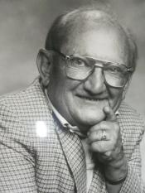
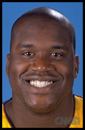
Human Variation
Watusi
Pygmy
Dwarfism
Basketball players
Eskimo (Inuit)
Billy Barty 3-foot-9
Shaquille O'neal 7-foot -1
This is an example of genetic variation and natural selection and NOT evolution

Slide 91
Mutation
Detrimental
Neutral
Beneficial
Disease
No change
Add information
No
Yes
No evolution
No evolution
Change morphology
yes
No
Evolution possible
No evolution

Slide 92
Mutations and Evolution
Jonathan Wells, Ph.D. Molecular Biology
“But there is no evidence that DNA mutations can provide the sorts of variation needed for evolution…
There is no evidence for beneficial mutations at the level of macroevolution, but there is also no evidence at the level of what is commonly regarded as microevolution.”

Slide 93
Mutations and Evolution
Maxim D. Frank-Kamenetski, Unraveling DNA, 1997, p. 72.
(Professor at Brown U. Center for Advanced Biotechnology and Biomedical Engineering)
“Mutations are rare phenomena, and a simultaneous change of even two amino acid residues in one protein is totally unlikely. …
One could think, for instance, that by constantly changing amino acids one by one, it will eventually be possible to change the entire sequence substantially…
continued

Slide 94
These minor changes, however, are bound to eventually result in a situation in which the enzyme has ceased to perform its previous function but has not yet begun its 'new duties'. It is at this point it will be destroyed – along with the organism carrying it.”

Slide 95
Mutations and Evolution
Lee Spetner (Ph.D. Physics – MIT, taught information and communications at Johns Hopkins University), Not By Chance, 1997, pp. 131, 138.
“But in all the reading I've done in the life-sciences literature, I've never found a mutation that added information…
All point mutations that have been studied on the molecular level turn out to reduce the genetic information and not increase it.”

Slide 96
Mutations and Evolution
Ernst Chain (Biochemist and Nobel Prize winner), Responsibility and the Scientist in Modern Western Society, London: Council of Christians and Jews, 1970, p.25.
“…that the development and survival of the fittest is entirely a consequence of chance mutations, or even that nature carries out experiments by trial and error through mutations in order to create living systems better fitted to survive, seems to be a hypothesis based on no evidence….”

Slide 97
Mutations and Evolution
Ray Bohlin, (Ph.D. in molecular and cell biology), Creation, Evolution, and Modern Science, 2000, p. 41.
“We see the apparent inability of mutations truly to contribute to the origin of new structures. The theory of gene duplication in its present form is unable to account for the origin of new genetic information – a must for any theory of evolutionary mechanism.”

Slide 98
Mutations
Kurt Wise (Ph.D. Paleontology), Faith, Form, and Time, 2002, p. 163.
“Of carefully studied mutations, most have been found to be harmful to organisms,…
Mutations that are actually beneficial are extraordinarily rare and involve insignificant changes. Mutations seem to be much more degenerative than constructive,…
Additionally, the number of mutations in organisms seems closer to the number that might be generated in thousands rather than billions of years of life history.”

Slide 99
Statement of Scientific Dissent from Darwinism
Signed by over 100 scientists
www.ReviewEvolution.com
“We are skeptical of claims for the ability of random mutation and natural selection to account for the complexity of life. Careful examination of the evidence for Darwinian theory should be encouraged.”

Slide 100
Information: The Key to Change
Werner Gitt, In the Beginning was Information, 1997, p. 106. (Dr. Gitt was the Director at the German Federal Institute of Physics and Technology)
“There is no known law of nature, no known process and no known sequence of events which can cause information to originate by itself in matter.”

Slide 101
Summary
History of mistakes
Neandertals were 100% human
Lucy and the australopithecines are extinct chimpanzee-like creatures
Deliberate misinformation in textbooks (Laetoli footprints)
No mechanism for change
A desperate attempt to censor information to protect evolution
What is evolution?

Slide 102
Summary
Stuart Kauffman (A leading thinker on self-organization and the science of complexity as applied to biology), At Home in the Universe, 1995, p. 43.
“Evolution is filled with these just-so stories, plausible scenarios for which no evidence can be found, stories we love to tell but on which we should place no intellectual reliance.”

Slide 103
The Majesty of God
Richard Swenson, M.D., More Than Meets the Eye, 2000, p. 17.
“As a scientist with training in both medicine and physics, it is easily apparent to me that the majesty of God is revealed in the human body.”

Slide 104
Summary
If the evolution of humans from an ape-like ancestor is true there should be two proof evidences:
1. Fossil record ……………
No intermediates
2. Mechanism for change ..
No mechanism

Slide 105
Conclusion
Giuseppe Sermonti, Ph.D. Genetics, Creation ex nihilo, 1993, p. 13.
“Many schools proclaim as a matter without any doubt that man has derived from the African apes….
This is a falsehood which any honest scientist should protest against. It is not balanced teaching. That which science has never demonstrated should be erased from any textbook and from our minds and remembered only as a joke in bad taste.
One should also teach people how many hoaxes have been plotted to support the theory of the simian (ape) origins of man.”

Slide 106
The Bible is the true
history of the world
Astronomy: In the beginning God created
Biology: Created after their kind
Anthropology: Made in the image and likeness of God
Geology: And behold, I, even I, do bring a flood of waters upon the earth

Slide 107
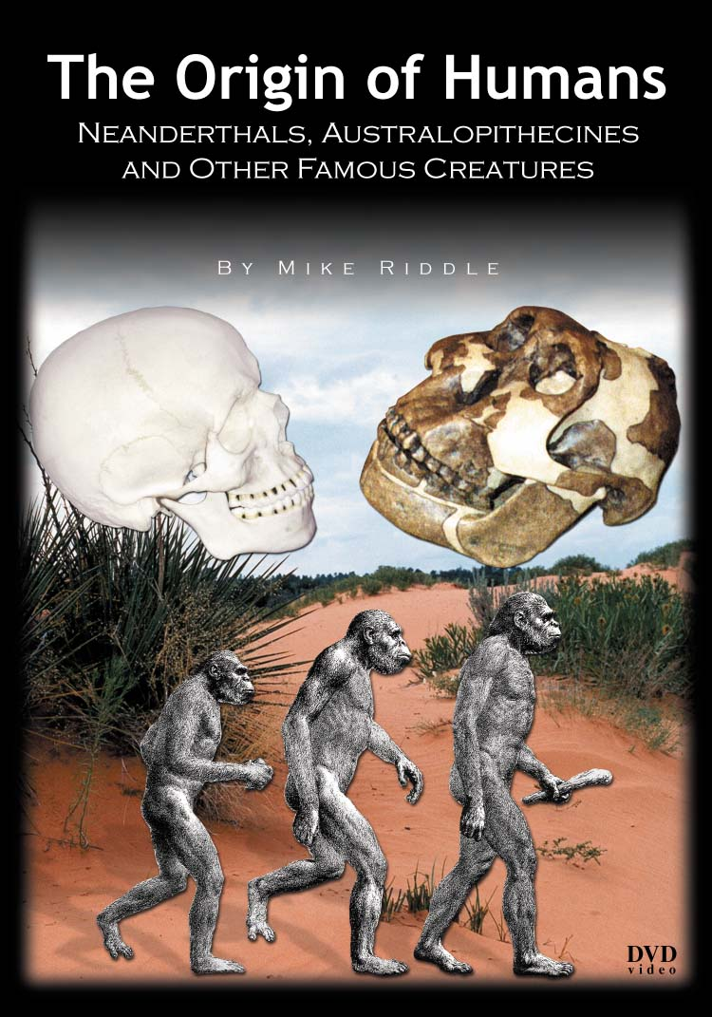
Six New DVDs

Slide 108
The Origin of Life
Equipping Course

Slide 109
A Training Guide on Understanding the Biblical Doctrine of Creation
Is evolution compatible with the Bible?
Does the Bible say how God created?
Is Genesis true history or just a story?
How long were the days of creation?

Slide 110
The Origin of Humans
Mike Riddle
Institute for Creation Research
Web Sites
www.icr.org
www.Train2Equip.com
www.answersingenesis.org

Slide 111
Black

Slide 112
Creation link at BibleStudyDownloads.org
Get this presentation for free!
Notes:
OT Survey (os)

